Slide 1

Fighting Together: Group Therapy for Tics
Mindy N. Meyer APRN-FPA, CPNP-PC, PMHS
CBIT Certified
Cayden Martinez-11 year old Tourette’s patient who has participated in groups

Slide 2
Why Consider a Group
CBIT behavioral intervention is considered the first line treatment by the American Academy of Neurology
CBIT is not easily accessible to many people
Shortage of CBIT providers
Possible additional gains to 1:1 CBIT
Treating Tourette Together Summit in 2019
  Research planning project to prioritize future research
  Four high priority domains
    Expanding treatment access
    Improving treatment outcomes
    Optimizing treatment within a broader care model
    Evaluating outcomes beyond tic severity
Bridge research practice gap

Slide 3
Evidence Supporting Group Therapy
Study done in 2020 of 3 months of group CBIT by Zimmerman-Brenner and colleagues
  Yale motor tic severity and Parent Tic Questionnaire showed decreased motor tics and was maintained
  Vocal tic severity based on Yale increased initially, and then decreased significantly at follow-up
  Co-morbid conditions (anxiety, behavior problems, and aggressive behavior) decreased following group CBIT
  Children with behavioral problems benefited less while those with higher intellectual ability benefited more
  This was compared to non-tic focused group and for those with a tic disorder did not show significant improvement

Slide 4
Evidence Supporting Group Therapy
Heijerman-Holtgrefe and associates tested outcomes on a 4 day intensive and comprehensive group-based program for children 9-17 years. Small study with 13 participants.
  Assessments with Yale Global Tic Severity Scale were done at start of group, post treatment, and 2 months post treatment.
  Showed improvement in tic severity and well as quality of life both post treatment and 2 months post treatment.
Group approach has been well studied for many other conditions and comorbidities related to tic disorders.

Slide 5
Demographics of the Groups
Boys 7-9
Boys 10-13
Girls 12-16
Teens 14-17
All with Chronic Tic Disorder or Tourette’s
Currently in treatment of some sort (CBIT, CBT, ABA, OT)
Comorbid conditions: allowed unless the child could not be safe without 1:1 assistance
Older teen or parent helper for younger groups

Slide 6

Rules vs Goals
Keep it easy, there is only one rule
Let the kids make the goals
List some reasonable goals below:
This Photo by Unknown Author is licensed under CC BY-NC-ND

Slide 7
Structure of Every Group
KEEP IT THE SAME
Review rules and goals
Review of how previous group went and if anything needs to be changed
Icebreaker
Overview of that specific session’s activities
Activities
Review of session

Slide 8

Rolling With It
Hold expectations lightly
Let the participants guide the discussion, as long as it is relevant
Use dynamics of group interactions to point out learning opportunities and things that go really well
Push GENTLY for sharing specifics
Re-center on goals if needed
Keep things as close to “real” life as possible
Observe aloud
This Photo by Unknown Author is licensed under CC BY

Slide 9
Outcomes
Parents self-reported gains from interacting with other parents while participants were in group
Participants: given survey below at start of 4 week group and at end
Red indicates answers at start of group
Green indicates answers at end of group
This chart is a lot to look at, here are some key take aways
  Participants got more confident explaining their tics to others
  Having tics stopped feeling lonely
  Wanting to work on tics didn’t change
  Awareness of tics went up
  Participants had more ways to calm down their tics.
 | 0-not at all | 1-very little | 2-sometimes | 3-almost always | 4-always
I feel confident explaining my tics to others |  |  | 4 3 | 0 2 | 2 1
Having tics is lonely | 2 6 | 3 0 | 1 0
I want to work on managing my tics |  | 0 1 | 3 2 | 1 1 | 2 2
I am aware of my tics |  | 1 1 | 0 1 | 4 3 | 1 1
Meeting new people is scary or makes me anxious | 2 2 | 1 1 | 2 3 | 2 1
I have ways to calm down my tics. |  | 1 0 | 1 1 | 3 2 | 1 3

Slide 10
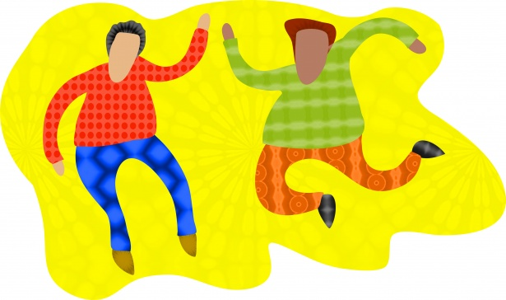
Example Activities
Icebreakers
  2 truths and a lie
  Orange races
  Blindfold trust of another group member
To do as we work on tics/response
  500
  Games
  Ask questions
  Share struggles
  Trace bodies

Slide 11
While Doing Activities
During natural transitions ask a question of group or single person
Talk through steps of managing a specific tic
Use general coping strategies for managing tic “storms”
Use competing responses as participate
Watch for chances to learn and use skills in real time
ALWAYS ask permission of each participant at start of each group as to their willingness to be singled out and to share
Remember a lot of participants start out not wanting to share but as they laugh and have fun they shift to more willingness

Slide 12

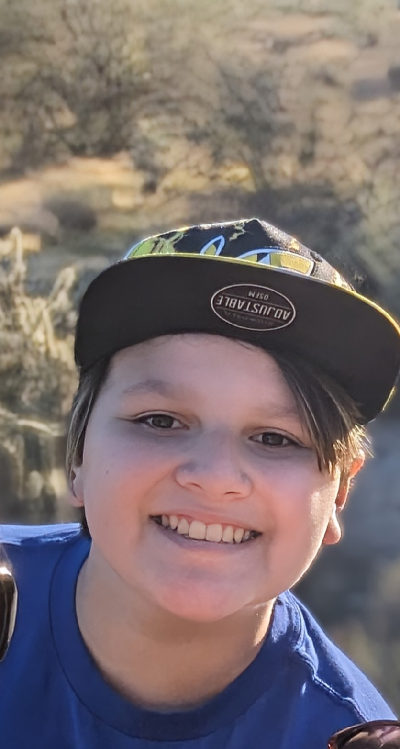

How Group Helped ME!
Use skills while doing various activities
It is difficult for other kids too
Know others are struggling just like me
I can still have fun, even though I have a disability
Ways to interact with others
Connected with people
Steps to manage tics
Helped other kids know what to do
Learned strategies from others

Slide 13
References
Conelea, C. A., Bennett, S., Himie, M., Hamilton, S., Hunt, C., Shineman, D., Mathews, C., & Capriotti, M. (2023). Treating tourette together: an agenda for patient-centered research focused on comprehensive behavioral intervention for tics. Behavioral Therapy, 6(005). https://doi.org/10.1016/j.beth.2023.06.005.com
Heijerman-Holtgrefe, A.P., Verdellen, C.W.J., van de Greient, J.M., Belijaars, L.P.L., Kan, K.J., Hoekstra, C., & Utens, E.M. (2021). Tackle your tics: pilot findings of a brief, intensive group-based exposure therapy program for children with tic disorders. European Child & Adolescent Psychiatry, 30:461-473.
Zimmerman-Brenner, S., Pilowsky-Peleg, T., Rachamim, L., Ben-Zvi, A., Gur, N., Murphy, T., Fattal-Valevski, A., & Rotsein, M. (2021) Group behavioral interventions for tics and comorbid symptoms in children with chronic tic disorders. European Child & Adolescent Psychiatry, https://doi.org/10.1007/s00787-020-01702-5.com.

