Slide 1
We All Think Differently!
Let’s learn about neurodiversity together.
Notes:
Hello, everyone. Did you know that we all have different brains and think differently? Today we are going to learn about neurodiversity, which may be a new term or idea for many of you.

Slide 2
What will we learn about today?
Strengths and Challenges
Neurodiversity
Abilities
We will learn what the word neurodiversity means.
We will learn about our own abilities or brain power.
We will consider the strengths and challenges that may affect someone who is neurodiverse.
Notes:
This is what we’ll be doing together today:
We will learn what the word neurodiversity means.
You’ll get to learn about your own brain and the things that it can do.
And we’ll think about the strengths and challenges that may affect someone who has a neurodiverse brain.

Slide 3
How are you?
Happy
Excited
Silly
Energized
Confident
Frustrated
Loved
Grateful
Surprised
Thoughtful
Calm
Worried
Sensitive
Tired
Bored
Sad
Jealous
Angry
zzz
Notes:
Let's do a quick check-in before we get started. How is everyone feeling right now? Find the face or emotion that expresses how you are feeling… If you'd like, you can share by raising your hand or you can think about it quietly to yourself.

Slide 4

What is a group agreement?
Group agreements:
Are our responsibility
Make everyone feel included
Let us be ourselves
Help us feel safe sharing our ideas
Tell us how to behave towards one another
Notes:
Now I want us all to work together to create a brave and welcoming space for each other.
A way to help us create this brave space is to have group agreements. Group agreements are our responsibility as a class. They make everyone feel included and let us be ourselves. Group agreements also help us feel safe sharing our ideas with each other and they tell us how to behave towards one another.
No one knows everything, but Together we know a lot. This means that all of our voices are respected here and I welcome your thoughts into our conversations so as a group we can learn from each other and build our knowledge together. [Read the characteristics of group agreements from the slide.]

Slide 5




Our Group Agreements
Listen while others are talking.
Give others time to think before we answer.
Use positive words to show understanding. Avoid judgement and criticism.
We can “pass” and choose not to answer a question.
Notes:
Here are our group agreements:
When one person talks, we should all listen and should not be having side conversations.
Sometimes we need to wait before giving the answer. We need to gives others time to think and process their thoughts. Some classmates do this quickly and others take their time; we all deserve a chance to speak up.
We should use positive words to show we understand, care, and may share the same thoughts as someone else. We should not judge or criticize others because they have different opinions or feelings than we do.
You can choose to “pass” or not answer a question if you do not feel well or comfortable answering a question. You will not be judged for not knowing something or not wanting to talk today.
Does anyone have any other ideas or agreements they’d like to suggest for us?
Can we all agree with these group agreements or promises to each other? Please give me a thumbs up if you can agree or thumbs down if you have questions or cannot agree and we can talk about it some more.

Slide 6





Let’s Have a Mindful Moment
Take a deep breath, focus your attention on…
5 things you can see
4 things
you can hear
3 things
you can touch
2 things
you can smell
1 thing
you can taste
Notes:
[Note to educator/facilitator: Choose between a mindful moment (Slide 6) or movement break (Slide 7) for the class.]
Movement breaks and meditation or mindfulness activities are good ideas for everyone. People may benefit even more from movement breaks and meditation throughout the day if they are feeling stressed or anxious. These types of breaks can help everyone’s brain stay fresh and calm, but some people may need more breaks throughout the day.
Let's do one now.
[Mindfulness option]
Now let's take a mindful moment! We can start by getting comfortable in our seats and taking a few deep breaths together to ground or settle ourselves. Next, I'll guide you through a mindfulness exercise using our 5 senses to focus our attention on things in our environment or the room. I'd like you to find...
5 different objects you can see
4 different sounds you can hear
3 items you can touch (without leaving your desk)
2 things you can smell
1 thing you can taste (without eating something).
Note to facilitator:
This activity is great to use when participants are feeling overwhelmed or flooded with emotions. Move through this activity slowly and mindfully.

Slide 7

Let’s Take a Movement Break
Notes:
[Movement break option]
Movement breaks and meditation or mindfulness activities are good ideas for everyone. People may benefit even more from movement breaks and meditation throughout the day if they are feeling stressed or anxious. These types of breaks can help everyone’s brain stay fresh and calm, but some people may need more breaks throughout the day.
Let's do one now.
Let's take a moment to gently move our bodies while seated at our desks! We can start by getting comfortable in our seats and taking a few deep breaths together to ground or settle ourselves. Next, I'll guide you through some stretches. Please feel free to skip or adapt any of these movements. Let's...
gently move our neck from side to side
slowly circle our neck to the right and to the left
roll our shoulders back a few times
hold our arms out in front of us, pointing our finger tips down and then up to stretch our wrists
gently circle our wrists
bring our right arm across the chest and then the left to stretch the shoulders and back
stand up and shake our arms and legs out
and then sit back down and circle our ankles

Slide 8
Neurodiversity
Notes:
Now it’s time to learn about neurodiversity…

Slide 9
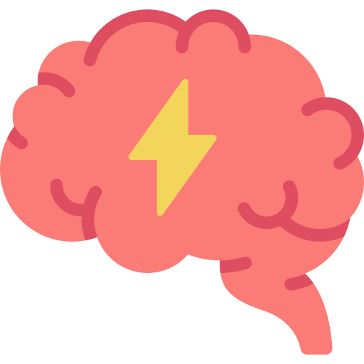

What is neurodiversity?
Neuro
Brain
Nervous System
Body
Five Senses
Diversity
Different
There are many different types of brains, and we all think and process differently.
Notes:
Let’s first begin by breaking up the big word Neurodiversity into smaller parts... Neuro means the brain and the nervous system. The nervous system goes from your brain to all your body parts, like the arms and legs. It receives and sends messages from your body to your brain. For example, if you touch something hot, your fingers feel pain and it is your nervous system that tells your brain that you touched something hot. Your nervous system uses the five senses: hearing, smelling, touching, tasting, seeing to know what is happening to your body and sends the messages to your brain.
Diversity means different!
If we put these words together again then what is Neurodiversity? Neurodiversity means that there are many different types of brains and that not all brains work in the same way. Each and every one of us is unique, our brains have different abilities, which creates the different ways that we all behave.

Slide 10

What does neurocognitive mean?
Neuro
Brain
Nervous System
Cognitive
How we think, explore, and figure things out.
Notes:
Let’s learn about another big word… Neurocognitive!
Remember that neuro means brain and nervous system. Cognitive means how we think, explore, and figure things out.

Slide 11





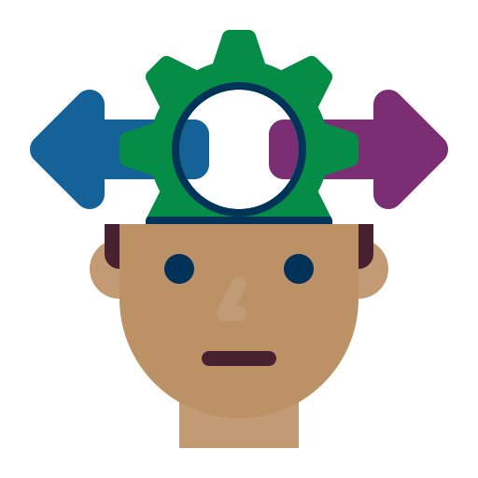
Brain Power: Our Six Neurocognitive Abilities
Moving and Seeing
Communicating
Learning & Remembering
Understanding Others
Paying Attention
Making Choices
Notes:
So, let’s talk about 6 of the amazing things that your brain can do. We’ll call these neurocognitive abilities or your brain power!
Moving and seeing: helps you understand what your brain is seeing through your eyes and how to move your body so you can run in gym class or play a sport.
Communicating: helps you to think, talk, and explain what you are thinking to others or help write your thoughts down when you do not feel comfortable saying them out loud.
Learning and remembering: helps you learn new things and keeps them stored away in your memory, like remembering what the teacher taught you in school so you can do your homework at home.
Understanding others: helps you understand other people’s feelings, thoughts, and how they see things.
Paying attention: helps you pay attention and stay focused - for example, to stay focused on the teacher, you try not to get distracted by friends, noises in the classroom or people walking down the hallway outside the classroom. The brain also helps you think fast and do puzzles.
Making choices: helps you pause, take a moment to think, and listen to others’ advice - so you can make the right choices for you in your life.
These are just some of the many things that you brain can do. These are 6 ways that your brain thinks and how that helps you every day in your life.
[Action – Teacher to do] Make sure to pause & prompt for questions to check for understanding
------------------------
[Notes for the Teacher] All 6 domains (i.e., abilities) are referenced from slide 14. Below is the equivalent for your reference to see how they were translated to age-appropriate language and examples.
Perceptual- Motor Function = Seeing & Movement (ex: good at sports, gym class, obstacle courses)
Language = Talk/Communicate (ex: good talker, good at writing/reading)
Learning & Memory = Learning & Memory (ex. remember things you learn from one day to the next)
Social Cognition = Understanding Others (ex: seeing others point of view, understanding their feelings, empathy)
Complex Attention = Pay Attention/Focus (ex. stay focused for a long time, fast thinker, solve a puzzle/challenge/rhyme quickly)
Executive Function = Make Choices/Listen (ex. pause, take time to think and make a choice, listen to others so they can help you learn)
Resources for the Teacher:
Altoida (Jan 2022). Defining the 6 Key Domains of Cognitive Function
https://altoida.com/blog/defining-the-6-key-domains-of-cognitive-function/#:~:text=The%20DSM%2D5%20defines%20six,motor%20control%2C%20and%20social%20cognition.
Sachdev, P. S., Blacker, D., Blazer, D. G., Gnaguli, M., Jeste, D. V., Paulsen, J. S., & Petersen, R. C. (2014). Classifying neurocognitive disorders: the DSM‑5 approach.
https://www.researchgate.net/publication/266325299_Classifying_neurocognitive_disorders_The_DSM-5_approach

Slide 12

Activity
Notes:
Now I am going to pass out a worksheet…

Slide 13




Activity: My Brain Power Superhero
What is your brain’s superpower?
What is an ability you’d
like to work on?
Name your
superhero!
How can you use
your superpower
in the classroom?
Notes:
Let’s work through it together.

Slide 14
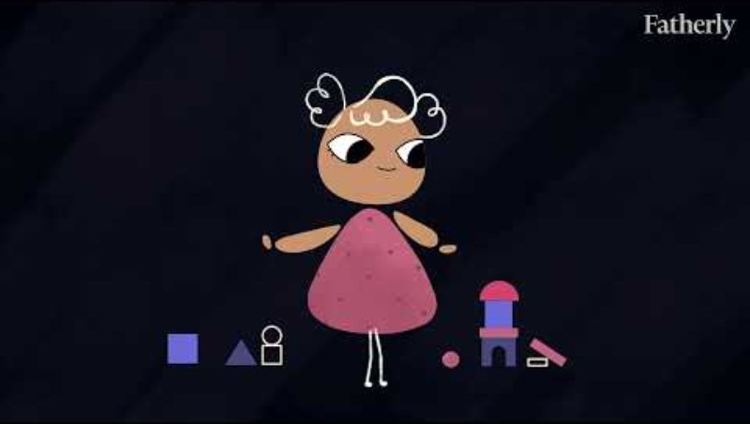
Notes:
Thank you for lettings us all know what your brain’s superpowers are. We all have different brains!
We are going to explore how important it is that we understand that each one of us learns and thinks differently. When we understand this, we can work together and help each other grow, learn and succeed. Let’s watch this video together.

Slide 15

Some Brains
The teacher gives the class instructions on a project. The teacher says, “Let’s begin working on our projects. Pull out your notebook and start brainstorming ideas for your topic.”
Many students with neurotypical brains will probably listen to the instructions and follow the directions, probably getting right to work listing out topics.
Notes:
Now, imagine a teacher gives the class instructions on a project. They say “Let’s begin working on our projects! Pull out your notebook and start brainstorming ideas for your topic”.
A student who has a neurotypical brain will listen to the instructions and follow the directions. They’ll immediately get to work!

Slide 16

Other Brains
The teacher gives the class instructions on a project. The teacher says, “Let’s begin working on our projects. Pull out your notebook and start brainstorming ideas for your topic.”
Students with neurodiverse brains may think about instructions differently.
Notes:
Now, imagine a teacher gives the class the same instructions on a project. They say “Let’s begin working on our projects! Pull out your notebook and start brainstorming ideas for your topic”.
Remember, people think and learn differently...
A student who has a neurodiverse brain may need support in different ways.
For example, students with Tourette Syndrome, might think about the instructions differently. A student who has a neurodiverse brain can may take longer to process the directions and may need additional help and patience.
They may ask the teacher “Can you repeat the instructions, please?” OR “I don’t understand what you mean?”
Or get stressed or upset and think “What if I get it wrong?” then wonder “I don’t think I can do this!” Students with neurodiverse brains learn to ask for help when they need it (which is a skill we can all benefit from learning)!
Teachers and other adults can support students with neurodiverse brains in different ways. One is by giving them more breaks in the day. Other ways may be repeating directions, helping a student get started on an assignment with a 1:1 moment realizing that a student may be feeling frustrated because they can do the work, but they just need help getting started. Or they may break the project down into smaller steps or show visual aids.
You can support your classmates as well by being patient, understanding, and kind.
------------------------
Resource for the Teacher:
A day in the life of a Neurodivergent vs a Neurotypical (2021) https://www.authenticallyemily.uk/blog/a-day-in-the-life-of-a-neurodivergent-vs-a-neurotypical

Slide 17
We all think differently!
There are many different types of brains.
Our brains have different abilities.
We all think and process differently.
Notes:
Thank you for being present and paying attention today as we learned about Neurodiversity and how important it is to our school. We took the time today to learn about neurodiversity because it helps us understand that we all have brains that think differently. It is important that we all know we think differently because there is no right or wrong type of brain.
We are all important and unique! Let's celebrate those differences together and show that we can accept and appreciate all the different brains that are in our classroom here today.

Slide 18
How are you?
Happy
Excited
Silly
Energized
Confident
Frustrated
Loved
Grateful
Surprised
Thoughtful
Calm
Worried
Sensitive
Tired
Bored
Sad
Jealous
Angry
zzz
Notes:
How are you feeling now?

Slide 19
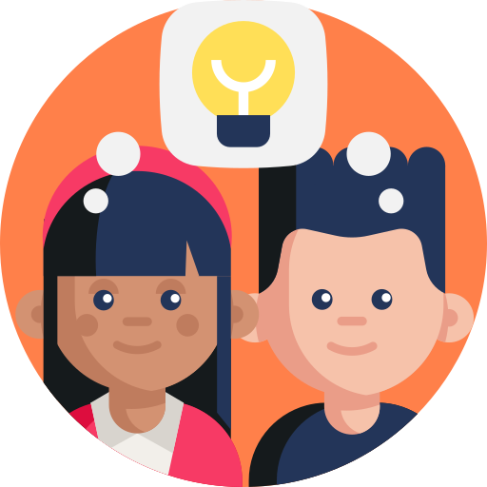
What did we learn today?
Reflection Question
What did you learn about neurodiversity today?
We learned about the word neurodiversity.
We considered our own abilities.
We thought about strengths and challenges that may affect someone who is neurodiverse.
Next time, we will learn about Tourette Syndrome.
Notes:
Let’s review what we learned today and take a moment to reflect. We will also introduce the topic we’ll discuss next time!

Slide 20
We All Think Differently!
Let’s learn about Tourette Syndrome together.
Notes:
Hello, everyone! Last time, we learned about neurodiversity. Today, we’ll review what we learned and also learn about Tourette Syndrome.

Slide 21
What will we learn about today?
Tourette Syndrome
Relationship Building
Neurodiversity
We will learn about Tourette Syndrome.
We will learn what makes a child with Tourette Syndrome neurodiverse.
We will practice how to build relationships with children who have Tourette Syndrome.
Last time, we learned about neurodiversity and our own brains’ abilities.
Notes:
Today we will learn 3 main things:
We will learn about Tourette Syndrome.
We will talk about what makes a child or person with Tourette Syndrome neurodiverse.
And we will practice how to build relationships with children/classmates who have Tourette Syndrome.

Slide 22
How are you?
Happy
Excited
Silly
Energized
Confident
Frustrated
Loved
Grateful
Surprised
Thoughtful
Calm
Worried
Sensitive
Tired
Bored
Sad
Jealous
Angry
zzz
Notes:
Let's do a quick check-in before we officially get started. How is everyone feeling right now?

Slide 23
Our Group Agreements
Listen while others are talking.
Give others time to think before we answer.
Use positive words to show understanding. Avoid judgement and criticism.
We can “pass” and choose not to answer a question.
Notes:
Let’s review our group agreements from the last time we learned about neurodiversity together.
When one person talks, we should all listen and should not be having side conversations.
Sometimes we need to wait before giving the answer. We need to give others time to think and process their thoughts. Some classmates do this quickly and others take their time; we all deserve a chance to speak up.
We should use positive words to show we understand, care, and may share the same thoughts as someone else. We should not judge or criticize others because they have different opinions or feelings than we do.
You can choose to “pass” or not answer a question if you do not feel well or comfortable answering a question. You will not be judged for not knowing something or not wanting to talk today.
Does anyone have any other ideas or agreements they’d like to suggest for us?
Can we all agree with these group agreements or promises to each other just like we did last time? Please give me a thumbs up if you can agree or thumbs down if you have questions or cannot agree and we can talk about it some more.

Slide 24
Tourette Syndrome
Notes:
So what is Tourette Syndrome?

Slide 25

What is Tourette Syndrome?
When someone has Tourette Syndrome (or TS), they make repeated sounds or movements that they cannot control.
Vocal tic: Sounds
Motor tic: Movements
Tics can be hardly noticeable or loud and easily seen.
Tics can change over time.
Notes:
When someone has Tourette Syndrome, also called TS for short, they make repeated sounds or movements that they cannot control. When this happens, it is called a tic. When it is a sound, it is called a vocal tic. When it is a movement, it is called a motor tic.
Tics can happen in the areas of the head and neck when people are young then appear later in the arms, legs and other parts of the body.
Tics can be hardly noticeable or loud and easily seen.
Tics can change over time.
It is important to understand that just having a tic does not mean that a person has a Tic Disorder. To have Tourette Syndrome means that a person has a certain number and types of tics (at least two different motor tics and at least one vocal tic) and has had tics for over a year. Before we move on, let’s do a brief activity.
Motor tics involve your muscles and movement in your body in ways you cannot control. Vocal tics are about the sounds a person makes, such as making a noise or saying words that they cannot control.
Can you guess which action is a motor tic and which action is a vocal tic? Using your handout – circle the actions that you think are motor tics and underline the actions you think are vocal tics.
[Action – Teacher to do] Pause and have students work for about 1-2 minutes and then share out a few examples.
[Notes for the Teacher] Activity 1 answer key for the teacher reference
Motor Tics:
eyes blinking fast,
moving jaws,
neck stretching,
arms or hands jerking,
head bobbing,
Shoulder shrugging,
Vocal Tics:
whistling,
humming,
yelling out,
clearing throat,
snorting,
hissing
[Resources for the Teacher]
“Five Things You May Not Know About Tourette Syndrome” https://www.cdc.gov/ncbddd/

Slide 26


Two Types of Tics
Motor Tics
Blinking eyes
Moving mouth or jaw
Stretching neck
Jerking arms or hands
Bobbing head
Shrugging shoulders
Vocal Tics
Whistling
Humming
Clearing throat
Snorting
Saying inappropriate things
Hissing
Notes:
Great job everyone here are the motor and vocal tics.
Examples of motor tics are:
Examples of vocal tics are:
Involuntarily saying inappropriate words or phrases is called COPROLALIA. These words or phrases may be difficult to hear and understand why the person with TS says them. A person with TS or a Tic Disorder may have coprolalia and does not mean to say these words; this does not reflect how the person really thinks and feels. Sometimes this is what people think of first when they think about TS. Not everyone with TS has coprolalia.
People with Tourette Syndrome may have different body movements for their tics. Sometimes only one part of their body may move and sometimes more than one part might show movements at the same time. For example, they might not be able to stop blinking their eyes and clearing their throat at the same time.
Tics can be different for every person. They can go from mild to severe, some people can have many tics, while others have only a few. This can change over time and tics can happen more when people are stressed, nervous, excited, tired, or sick.

Slide 27
Tourette Syndrome
1 in 162
1 in 50
5 – 7 Years Old
Children in the U.S. has Tourette Syndrome
Children in the U.S. between 5 – 14 years old has Tourette Syndrome or another persistent Tic Disorder.
Most children with a Tic Disorder have their first noticeable tic when they are 5 – 7 years old.
Source: Data and Statistics on Tourette Syndrome | Tourette Syndrome | CDC
Notes:
According to the CDC, 1 out of 162 children in the US has Tourette Syndrome. We also know that among children 5-14 years of age, 1 in 50 has Tourette Syndrome or another persistent Tic Disorder.
To help us understand these numbers, we can think about it this way: If there are 25 children in a fourth-grade classroom, then there are 50 children in two classrooms. It is likely that one student out of these two classrooms has a diagnosis of TS or another tic disorder. This number is here to show you that it is not uncommon for people to have tics. This does not mean that someone in your class or the class next to you has a TS or Tic Disorder diagnosis. It just means that this is how common it can be: you will probably meet someone with a TS or Tic Disorder diagnosis in your lifetime.
Tourette Syndrome affects children and adults of all races, ethnicities, genders, and ages. Scientists are still figuring out what causes Tourette Syndrome but they do know that it can be genetic, which means people can be born with it.
TS is diagnosed by a doctor, usually a doctor called a neurologist. Neurologists specialize in disorders of the brain and nervous system.
Most children with Tourette Syndrome will have their first noticeable tic between the ages of 5-7 years old.

Slide 28
Tourette Syndrome and Neurodiversity
Notes:
Let’s learn what makes a person with Tourette Syndrome neurodiverse…

Slide 29
What is neurodiversity?
Neuro
Brain
Nervous System
Body
Five Senses
Diversity
Different
There are many different types of brains, and we all think and process differently.
Notes:
Let’s review what neurodiversity means… Let’s begin by breaking up the big word neurodiversity into smaller parts... Neuro means the brain and the nervous system. The nervous system goes from your brain to all your body parts, like the arms and legs. It receives and sends messages from your body to your brain. For example, if you touch something hot, your fingers feel pain and it is your nervous system that tells your brain that you touched something hot. Your nervous system uses the five senses: hearing, smelling, touching, tasting, seeing to know what is happening to your body and sends the messages to your brain.
Diversity means different!
If we put these words together again then what is Neurodiversity? Neurodiversity means that there are many different types of brains and that not all brains work in the same way. Each and everyone of us is unique, our brains have different abilities, which creates the different ways that we all behave.

Slide 30

Tourette Syndrome
People with Tourette Syndrome are neurodiverse.
The brain works differently for people who have Tourette Syndrome.
The part of the brain that makes people do things and determines when they do those things is different. This can cause tics.
Notes:
People with TS have parts of their brains that are different from other brains. The part of the brain that makes people do things and determines when they do those things is different. This can cause tics.
Each and every one of us is unique and some people may need help or support so they can learn. The idea of neurodiversity helps us understand that brains are different, and there is no right or wrong type of brain.

Slide 31
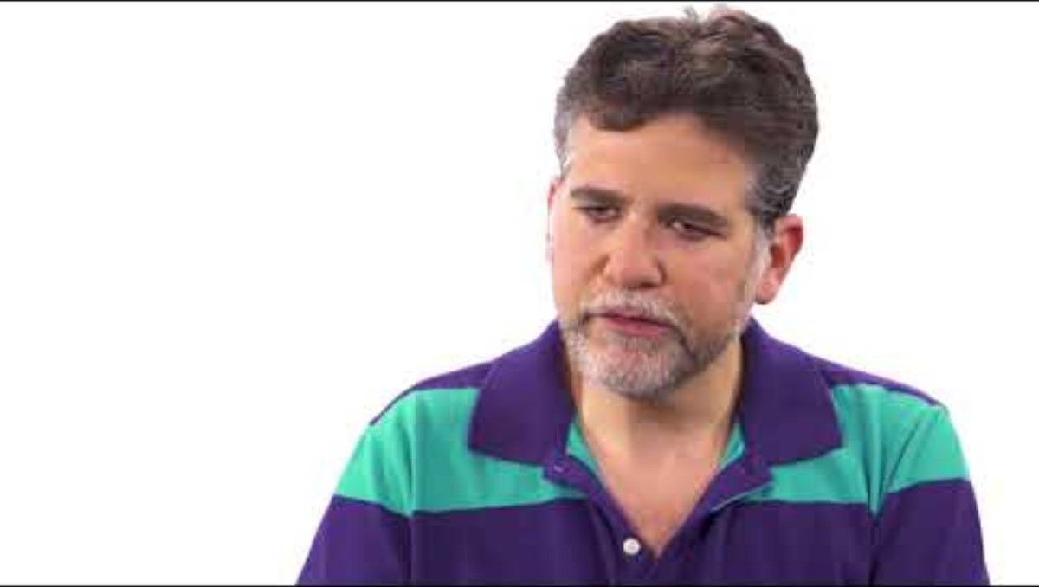
Notes:
People who have Tourette Syndrome are neurodiverse. That means that their brain works differently than others. Let’s watch and find out more. While the video portrays older children and adults, younger children may also have these same or similar tics.

Slide 32
Building Relationships
Notes:
Now that we have learned more about Tourette Syndrome, let’s talk about a few ways that we build relationships or friendships with each other…

Slide 33
Brain Power: Our Six Neurocognitive Abilities
Moving and Seeing
Communicating
Learning & Remembering
Understanding Others
Paying Attention
Making Choices
Notes:
Let’s review some of our brains’ unique abilities that we learned in Lesson 1. We are going to work on building relationships and friendships. As we review these abilities, let's remember that everyone's brain is different and some of these abilities may be more challenging for some people. Remember that some people may need support with achieving these abilities.
Moving and seeing: helps you understand what your brain is seeing through your eyes and how to move your body so you can run in gym class or play a sport.
Communicating: helps you to think, talk, and explain what you are thinking to others or help write your thoughts down when you do not feel comfortable saying them out loud.
Learning and remembering: helps you learn new things and keeps them stored away in your memory, like remembering what the teacher taught you in school so you can do your homework at home.
Understanding others: helps you understand other people’s feelings, thoughts, and how they see things.
Paying attention: helps you pay attention and stay focused - for example, to stay focused on the teacher, you try not to get distracted by friends, noises in the classroom or people walking down the hallway outside the classroom. The brain also helps you think fast and do puzzles.
Making choices: helps you pause, take a moment to think, and listen to others’ advice - so you can make the right choices for you in your life.

Slide 34
How do you make friends?
Being yourself
Saying hello
Asking questions
Joining a club or sport or team
Finding something in common
Being a good listener
Playing
Sharing a new experience
Notes:
So how do you make friends? Here are some examples. Which ones do you like? Do you have other ideas to add to this list?

Slide 35

Activity
Notes:
Let’s use what we just talked about (our brain power and ways we like to make friends) to do an activity together!

Slide 36
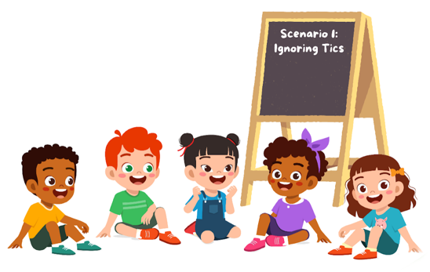
Activity: Small Group Scenarios
Let’s get into groups!
With your group:
Read the scenario (1-5) your teacher assigns to you.
Talk about what you can do to help, support, and be a good friend to the student.
Pick someone to speak for your group for the group share out afterwards.
Notes:
Let’s get into groups. I am going to have each student count off so we can get into groups. Then you will gather in your groups and you will do 3 things. First let's get into groups and then I can go over the instructions which are on the slide and on your worksheet that I will pass out.
[Action – for teacher to do] Put students into groups by doing a count off, such as 1, 2, 3, 4, and 5 then starting again 1, 2,….. counting again to have 5 so that 5 random groups are created.
Great now, that we are in groups, I will read the instructions out loud and when I am finished if you have any questions, please let me know. You can also read the instructions on your worksheet.
[Action – for teacher to do] Read instructions on slide, answer any questions students might have
Set time to end activity and save time for share-out.

Slide 37

Scenario 1: Vocal Tics
One of your classmates, Jodie, has Tourette Syndrome. She has vocal tics. During class, Jodie frequently whistles or says inappropriate things.
What could you do?
Notes:
Scenarios 1-6 have slides to facilitate reading and participation in this small group activity. All scenarios are also on the handout.

Slide 38

Scenario 2: Favorite Seat for Focusing
Jordan, who has Tourette Syndrome, always sits in the first row of desks in your classroom. Today there are no desks available where Jordan usually sits and he asks if he can have your seat in the first row. You say, “I’m sitting here! There is a seat open in the back row.” But Jordan says, “It’s tough for me to focus by the windows back there!”
How would you respond?

Slide 39

Scenario 3: Tics During Instructions
After your teacher finishes giving instructions for a project, your classmate Mei, who has Tourette Syndrome, is going through the papers on her desk and looking around at the other students who are starting their work. You noticed Mei seemed to be blinking repeatedly and clearing her throat while your teacher was giving the project instructions.
What could you do to help Mei?

Slide 40

Scenario 4: Help with Notetaking
Sofia is a student who has Tourette Syndrome in your classroom. You notice that her notes from class follow what the teacher says and start out neat. Her notes slowly become difficult to read and don’t always follow what the teacher says towards the end of class. She usually asks to see your notes when she can’t read or understand hers.
How could you help Sofia?

Slide 41

Scenario 5: Motor Tics
Simone, another student in your classroom, notices that Pablo, who has Tourette Syndrome, blinks his eyes and shrugs his shoulders frequently. Simone sometimes mimics Pablo's blinking and shrugging and she laughs at him.
What could you do next time?

Slide 42
How are you?
Happy
Excited
Silly
Energized
Confident
Frustrated
Loved
Grateful
Surprised
Thoughtful
Calm
Worried
Sensitive
Tired
Bored
Sad
Jealous
Angry
zzz
Notes:
How do you feel after that group activity?

Slide 43

What did we learn today?
Reflection Questions
What did you learn about Tourette Syndrome today?
Do you know why Tourette Syndrome is a neurodiverse condition?
We learned about Tourette Syndrome.
We learned that people with Tourette Syndrome have neurodiverse brains.
We talked about how we build relationships with other students.
Notes:
Now, let’s take a moment to reflect and to review everything we learned today. Thank you for being present and participating today!

